Slide 1
Website
WEB HOSTING
Software Engineering Group

Slide 2
Introduction
Websites are one of the most frequently accessed and used media in searching for various information and means of communication. The main factor occurs due to the development of the internet from year to year has increased in terms of active users. Everyone certainly accesses the internet using various devices, ranging from desktop, mobile, to tablets. Examples that are often used in everyday life are Google, Twitter, Facebook, Detik, CNN, and so on. Of course, the various websites available have different functions and features, some are engaged in e-commerce, social media, business, information media, and others.

Slide 3
TABLE OF CONTENTS
01
What is Website?
02
History of Website
03
Website Functions
04
Website Elements
05
Types of Websites
06
How to create a website

Slide 4
01
What is Website ?

Slide 5
Definition of Website
A website is a collection of pages in a domain that contains various information to be read and viewed by internet users through a search engine. Information that can be loaded generally contains images, illustrations, videos, and text content for various purposes.
Usually for the initial display can be accessed through the main page (homepage) using a browser by writing the right URL. In a homepage, it also contains several derivative web pages that are connected to one another.

Slide 6
02
History of Website

Slide 7
History of Website
The history of the web first began with a British scientist named Tim Berners-Lee. Berners' parents were also computer scientists in the early days of computing. The initial goal of Tim Berners was to make it easier for researchers at work to get and exchange information. Then, on April 30, 1993, CERN, a physics laboratory in Switzerland, officially announced the release of a free website. Prior to that in 1990, Tim Berners-Lee also wrote about three basic web technologies, namely HTML, URI, and HTTP.

Slide 8
HTML
HTML (HyperText Markup Language) It is a markup language or format for web pages.

Slide 9
URI
URI (Uniform Resource Identifier) is a unique address to open a web page. Its function is to identify every resource on the web. Nowadays it is often called a URL (Uniform Resource Locator).

Slide 10
HTTP
HTTP (HyperText Transfer Protocol) is an application layer network protocol developed to help the transfer process between computers. This protocol is useful for transferring information such as documents, files, images, and videos between computers.

Slide 11
03
Website Functions

Slide 12
1. Information tools
First, the function of the website is as a means to convey the latest and interesting information to be read by your customers. Basically, the website can also be used as a means of education, learning, tutorials, tips & tricks, and much more.
Examples as a means of information are news search sites, company profiles, and others. For the type of content, it can be in the form of video, text, and images.

Slide 13
2. As a blog
Have you ever read or opened a site that displays pages containing articles or reading material? If you have, then that is what is called a blog. People who often create blogs are called bloggers.
So this second function is to create a blog so that its main purpose is to get visitor traffic and optimize blogs that have been published. In addition, it can also function as a means to improve the company's brand to bring in more customers.

Slide 14
3. Platform for buying and selling
The last function is as a platform to accommodate the process of online buying and selling transactions or often referred to as e-commerce. By using a website, e-commerce is able to bring in more consumers to buy goods or services through the site that has been provided.
So basically, e-commerce here is only limited to intermediaries. Examples that implement this function are Tokopedia, Bukalapak, Amazon, Shopee, and others

Slide 15
04
Website Elements

Slide 16
These include
Domain Name
Script Program
Website Design
Web Hosting

Slide 17
Domain Name
Domain name or commonly referred to as Domain Name or URL is a unique address in the internet world that is used to identify a website, or in other words, a domain name is an address used to find a website in the internet world. Example: http://www.baliorange.net, http://www.detik.com
Domain names are freely traded on the internet with an annual rental status. The domain name itself has an extension / suffix identification according to the importance and location of the website's existence. Examples of domain names with international extensions are com, net, org, info, biz, name, ws. Examples of domain names with Indonesian extensions are co.id (for company website domain names), ac.id (education website domain names), go.id (government agency website domain names), or.id (organization website domain names).

Slide 18
Web Hosting
Web Hosting can be defined as the space contained in the hard disk where various data, files, images and so on that will be displayed on the website. The amount of data that can be entered depends on the amount of web hosting that is rented / owned, the bigger the web hosting, the bigger the data that can be entered and displayed on the website.
Web Hosting is also obtained by renting. The amount of hosting is determined by the hard disk space with the size of MB (Mega Byte) or GB (Giga Byte). The average length of web hosting rental is calculated per year. Hosting rentals are made from web hosting rental companies that are widely found both in Indonesia and abroad.

Slide 19
Script Program
Is the language used to translate every command on the website when accessed. The type of program language determines the static, dynamic or interactive nature of a website. The more variety of program languages used, the more dynamic and interactive the website will look and look good.
Various program languages are currently available to support the quality of the website. The types of program languages that are widely used by website designers include HTML, ASP, PHP, JSP, Java Scripts, Java applets, and so on. The basic language used by every website is HTML while PHP, ASP, JSP and others are supporting languages that act as dynamic and interactive organizers of the site. These languages are usually used to build news portals, articles, discussion forums, guest books, organization members, emails, mailing lists and so on that require constant updates.

Slide 20
Website Design
Website design determines the quality and beauty of a website. Design is very influential on visitors' assessment of whether a website is good or not.
To create a website, you can usually do it yourself or hire a website designer. Currently, there are many web designer services, especially in big cities. Please note that the quality of the site is determined by the quality of the designer. The more mastery of web designers about various programs / software supporting site creation, the higher quality sites will be produced, and vice versa. This web designer service generally requires the highest cost of all site development costs and it all depends on the quality of the designer

Slide 21
05
Types of Website

Slide 22
1. Blog
Blogs are websites that are widely used by people. Through this media you can upload a lot of diverse content ranging from articles, images, and videos.
Its more flexible use allows for more diverse functions as well.
Blogs can be a medium for channeling personal writings, opinions, reviews, promoting content, and other interests.
Usually, blogs are more dynamic because they are managed by active owners and more likely to have in-depth interactions with visitors.

Slide 23
2. E-Commerce Website
Through this website you can buy a product online. You can make transactions with sellers, as well as become one. Payments and offers are all done on the website.
This type of website is suitable if you want to create a website with the purpose of selling products online and become a place for other people to buy and sell.
In Indonesia, there are many eCommerce websites, such as Shopee, Tokopedia, Lazada, Bukalapak, and so on. Some well-known brands also have their own online store websites to promote their products.

Slide 24
3. Business Website
This website is the type that is built by a particular business. Its function is to communicate the type of products and or services provided by the business. Nowadays, a business should at least have a website. A business can reach more people as well as build business trust with a website.
If you look at the functions, you might be confused about the similarities between a business website and an eCommerce website. Indeed, there is no fundamental difference between the two types of websites. An eCommerce website can be called a business website, but a business website is not always an eCommerce website.

Slide 25
4. Government Website
The function of a government website is as a medium to convey information about government agencies ranging from programs, policies, services provided.
Usually, government websites use a special domain. For example in Indonesia, it is used by local governments in city districts, ministries, and state institutions.

Slide 26
5. Entertainment Website
One of the most popular types of websites is the entertainment website. To fulfill entertainment needs, these websites usually provide images, videos, movies, music, and a variety of other content that can entertain.
To build an entertainment website, you have to make sure and work to get an audience that matches the type of entertainment you will provide. Examples of entertainment websites that you can use as references include Netflix, 1cak, 9gag, YouTube, and so on.

Slide 27
6. Portfolio Website
Portfolio websites are usually used as personal websites as well. Both can be used as personal branding. Because in addition to having a list of previous jobs, this type of website displays information about the website owner and his portfolio.
Personal websites are usually used by public figures ranging from politicians to celebrities. Meanwhile, portfolio websites are widely used by freelancers and creative professionals. Through this website, it is hoped that someone will get a new project or job opportunity for the website creator.

Slide 28
7. Media Website or News Portal
Among the various types of websites are websites that collect and report news. This type of website benefits from advertisements that appear on its site. In addition, there are also websites that provide news by subscription or with a combination of both.
In Indonesia, there are many news portals that you can visit. Some types of news websites that you can visit are Detik, Tribunnews, Liputan6, Kompas, and so on.

Slide 29
8. Education Website
As the name itself, an educational website is a type that has a purpose for academic activities, such as providing educational materials and informing educational institutions to them.
To distinguish it from other types of websites, you can look at the domain used. For example, in Indonesia, the domains used are ac.id, edu, and .sch.id. However, this does not mean that websites with other domains are not commonly used. So, educational websites are usually built by educational institutions such as schools or universities.

Slide 30
9. Non-Profit Website
This type of website is used for social activities and usually does not make a profit. Examples are websites used for social service activities, fundraising, mutual aid activities, health service information and vaccines, and so on.
For non-profit organizations, it is usually important to create a website. This is important because it legitimizes the organization that has been formed. In addition, through this website, the organization will be able to reach more people.

Slide 31
10. Community Forum
The next type of website is for communities to communicate and collaborate on content.They are grouped into a community that has an interest in a particular topic.
In Indonesia, an example of a community forum is the Wiki community that tries to build Wikipedia content to be even better. In addition, there are also Detik Forum and Kaskus.

Slide 32
06
How to create a Website

Slide 33



WEBSITES

Slide 34
WEBSITES
FRONTEND
FULLSTACK
BACKEND

Slide 35
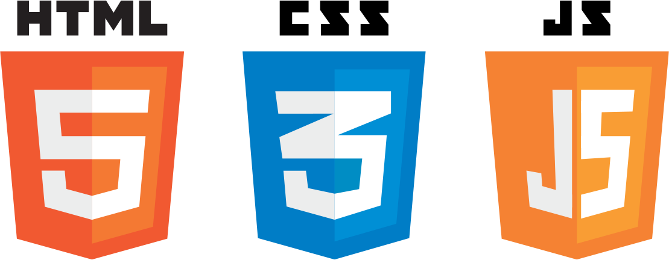

FRONTEND
OR

Slide 36



FRAMEWORKS

Slide 37



BACKEND

Slide 38



FRAMEWORKS

Slide 39
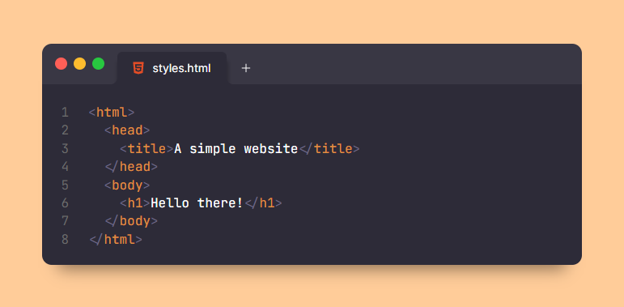
HTML

Slide 40
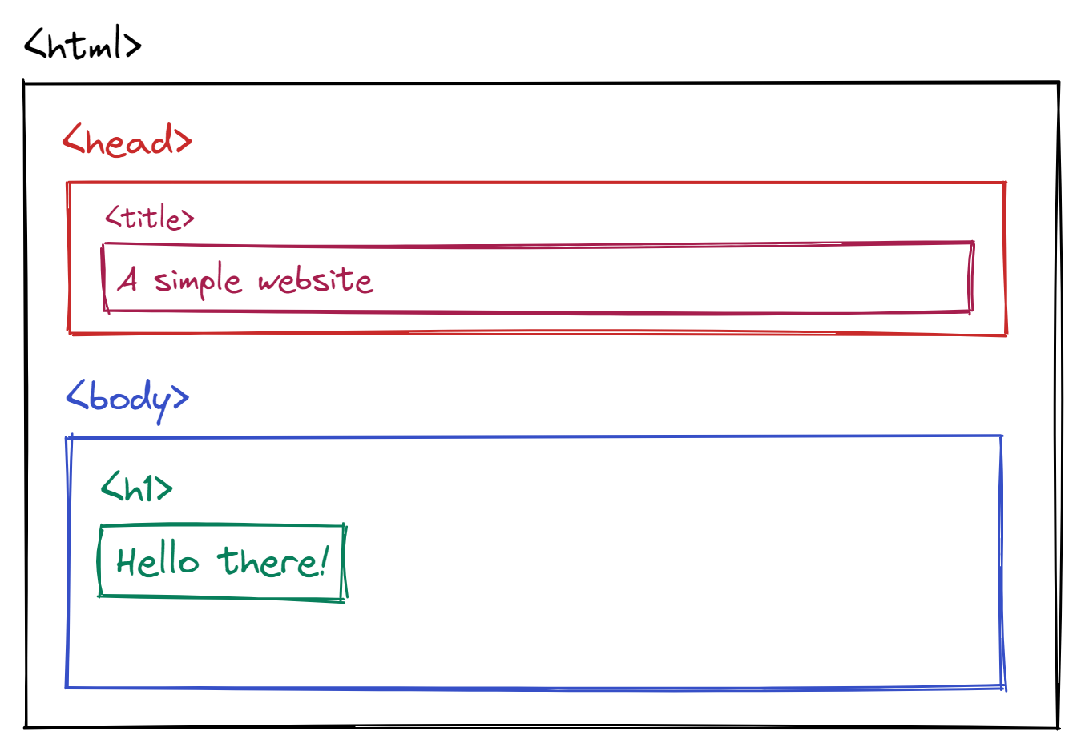

Slide 41
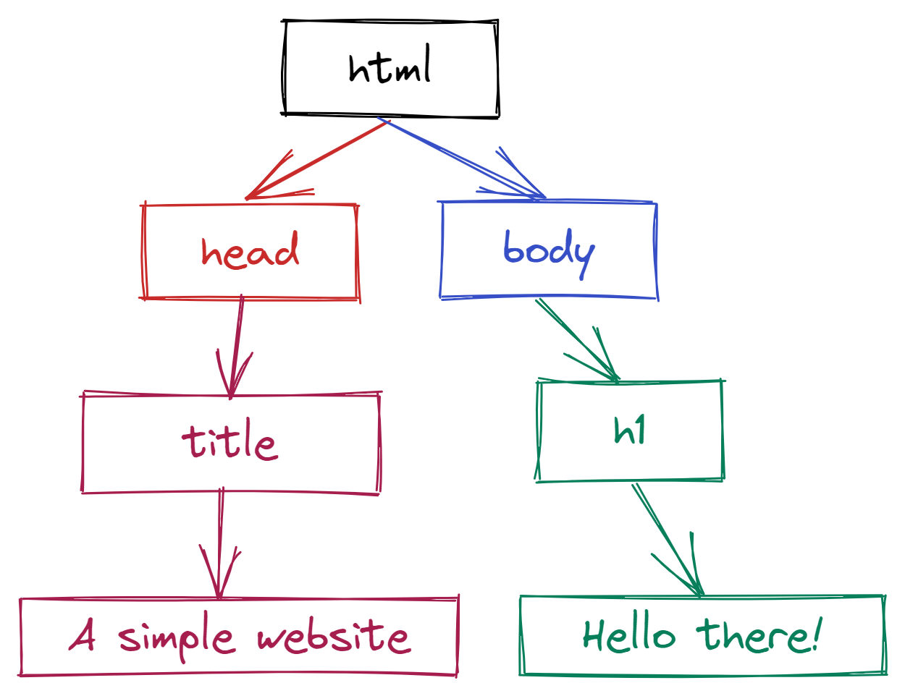

Slide 42
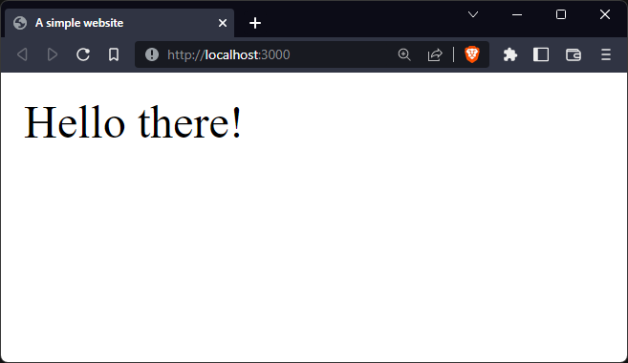

Slide 43
https://developer.mozilla.org/en-US/docs/Web/HTML

Slide 44
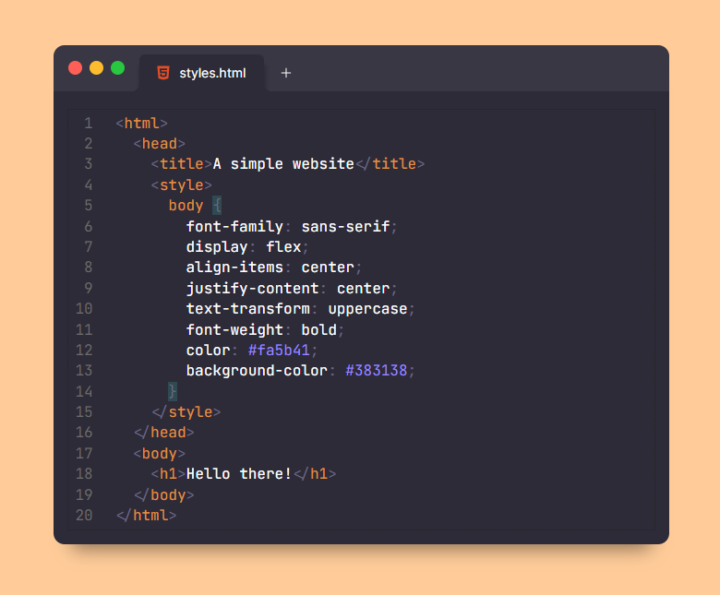
CSS

Slide 45
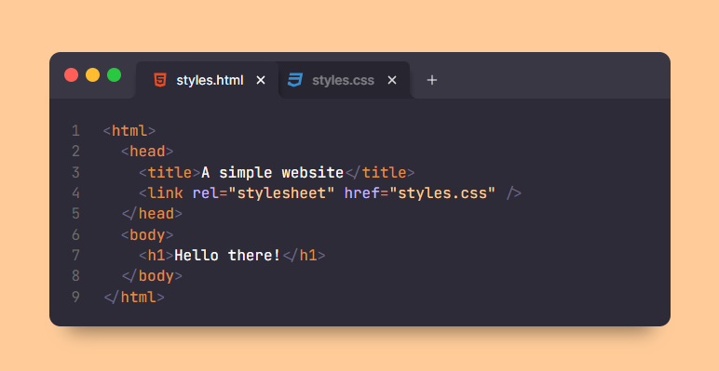
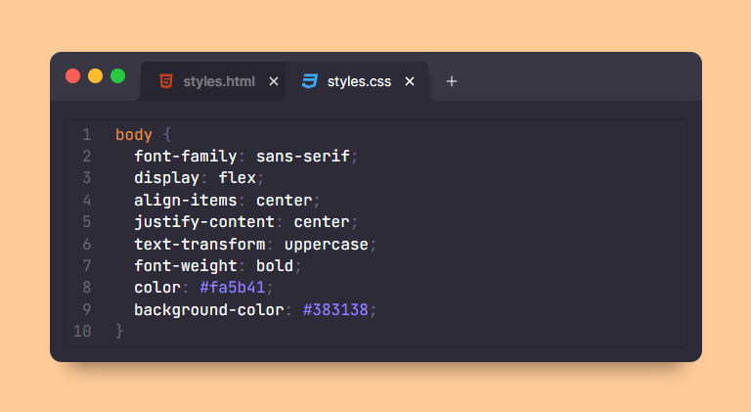
CSS

Slide 46
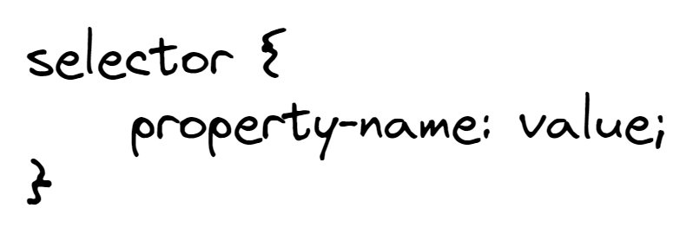

Slide 47
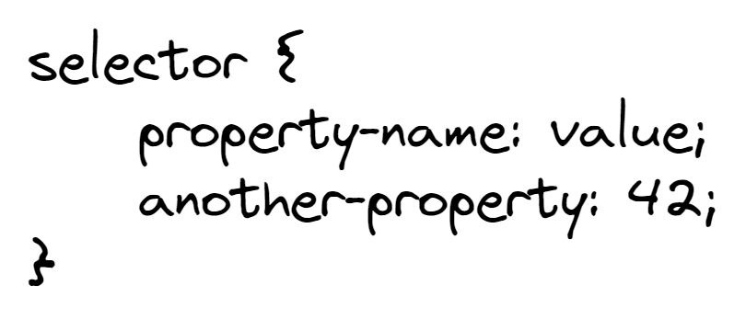

Slide 48
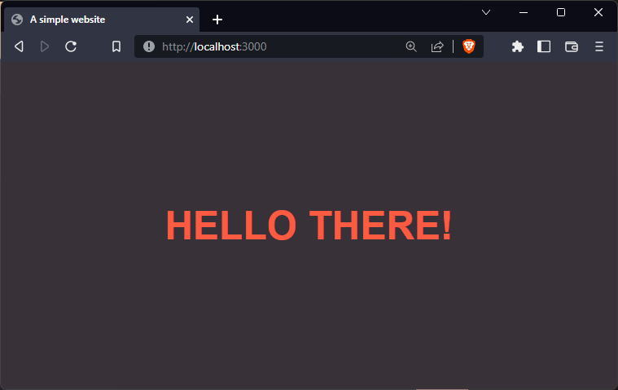

Slide 49
https://developer.mozilla.org/en-US/docs/Web/CSS

Slide 50
JavaScript

Slide 51
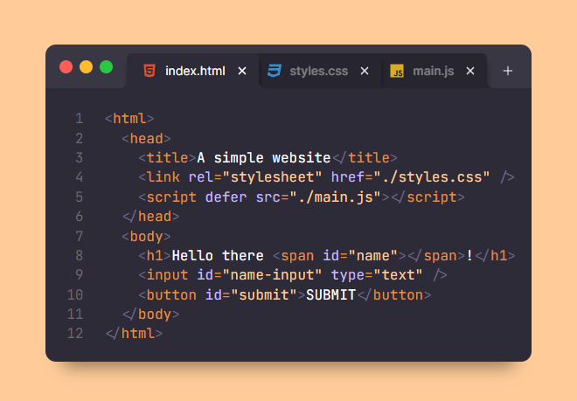

Slide 52
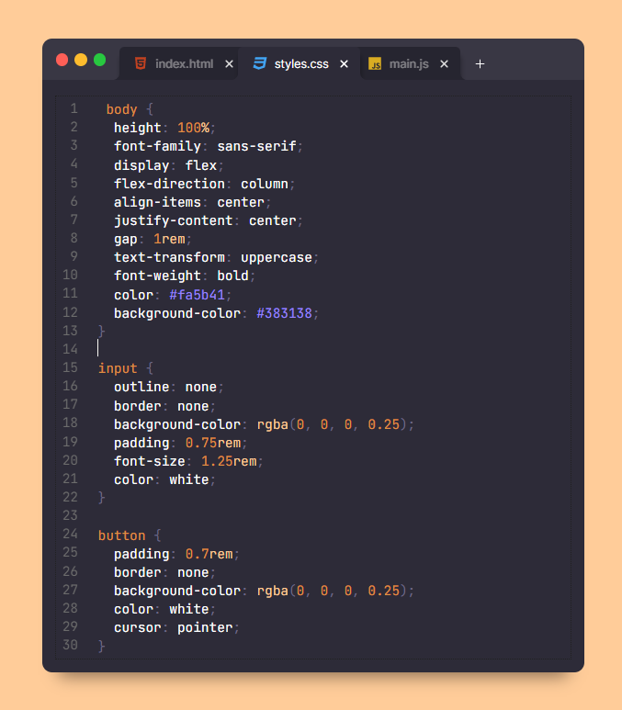

Slide 53
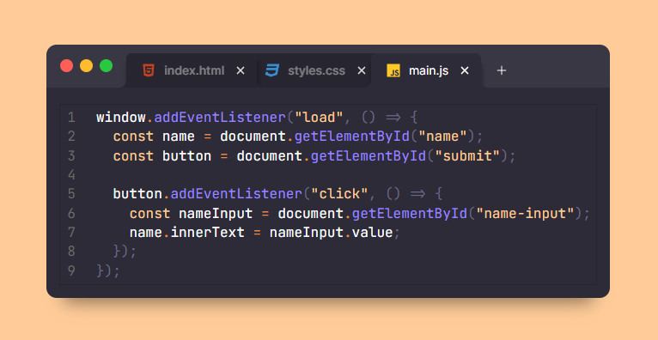

Slide 54
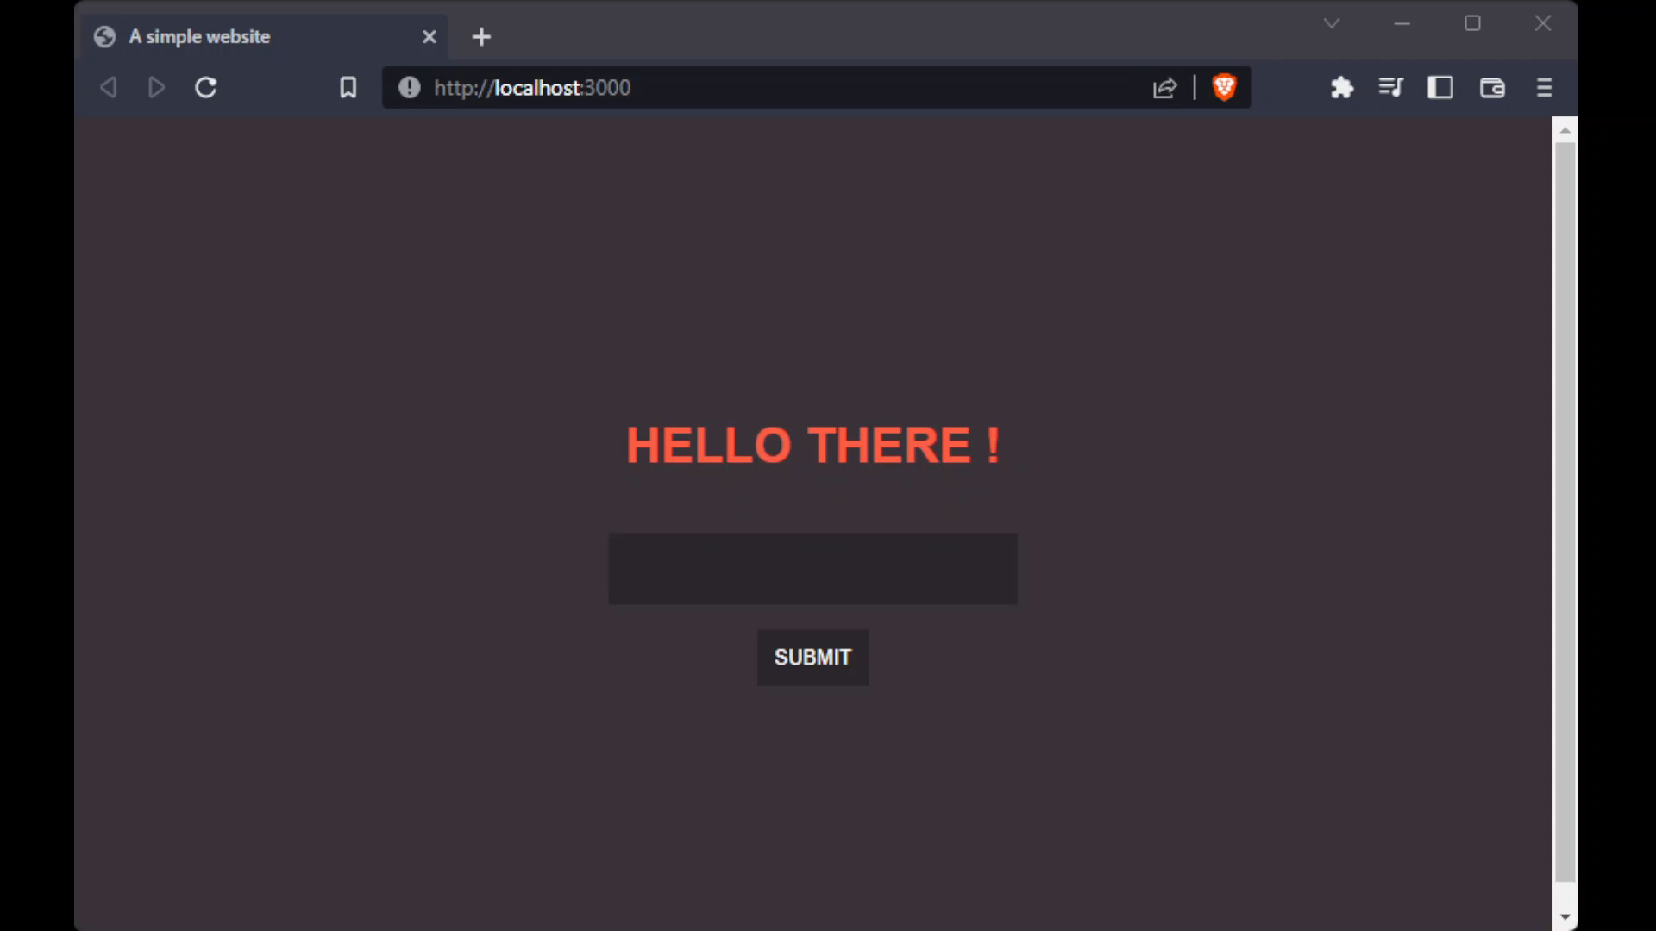

Slide 55
DEPLOYMENT
Shared Hosting (Domainesia, Hostinger, IDCloudHost, etc)
Virtual Private Server (VPS) (Digital Ocean, Vultr, Contabo, etc)
Content Delivery Network (CDN) (Cloudflare, Vercel, Netlify, etc)

Slide 56
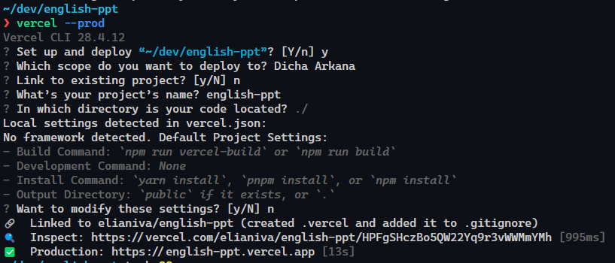
DEPLOYMENT

Slide 57
english-ppt.vercel.app
github.com/elianiva/english-ppt

Slide 58
WHAT’S NEXT?

Slide 59
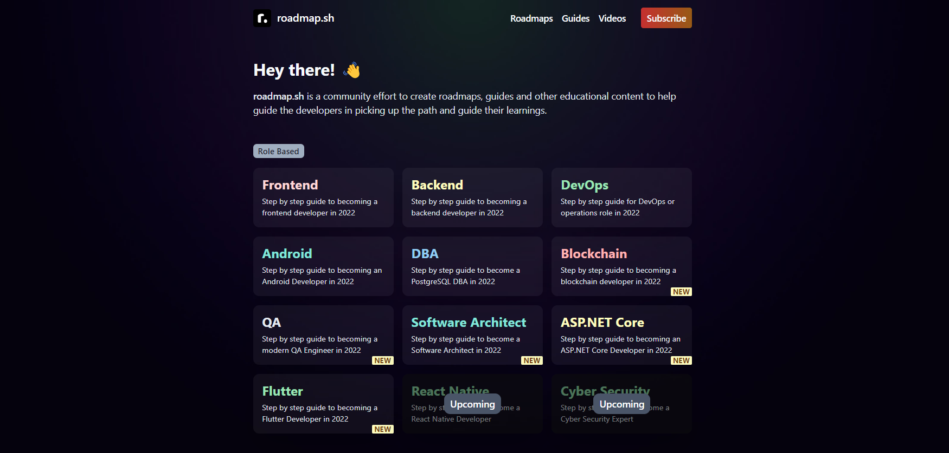

Slide 60
THANK YOU!

